Slide 1

Deadlock Detection & Resource Allocation Simulator
Guided by Mr. Muniraju Valamudi
Group : 07
Section : 06
B.Vaishnavi :2420090026
N.Hansika : 2420030420
Jayadeep : 2420030381
Vivek : 2420030350

Slide 2
Project Introduction & Goal
Operating systems manage multiple processes simultaneously
Each process requires limited resources (CPU, memory, I/O)
Improper allocation of these resources can lead to deadlocks
Deadlocks cause processes to get stuck indefinitely
this project simulates and detects deadlocks in real time.

Slide 3
Problem Statement
In real-world systems, processes continuously request and release resources dynamically
If resources are not allocated properly, processes may end up waiting for each other
This creates circular dependencies, which lead to deadlocks
Deadlocks reduce system performance and may even crash the system
Need for a system:
To detect deadlocks at an early stage
To prevent unsafe allocation of resources
To provide recovery strategies when deadlocks occur

Slide 4
Objectives
To simulate how processes interact with limited system resources.
To implement algorithms that detect and avoid deadlocks .
To identify whether the system is in a safe or unsafe state .
To generate safe execution sequences for processes .
To provide possible solutions for recovering from deadlocks

Slide 5
OS Concepts Used
Deadlock Conditions:
Mutual Exclusion – A resource can be used by only one process at a time
Hold and Wait – A process holds resources while waiting for others
No Preemption – Resources cannot be forcibly taken away
Circular Wait – Processes form a circular chain of dependencies
Other Concepts:
Resource Allocation – Managing how resources are distributed
Banker’s Algorithm – Used to avoid unsafe states
Wait-For Graph – Used to detect deadlocks through cycles

Slide 6
System Architecture
Workflow:
User inputs process and resource details.
Resource Allocation Module assigns resources to processes.
Banker’s Algorithm checks whether the system is in a safe state.
If unsafe, the Wait-For Graph is used to detect deadlocks.
The system then displays the final result
Safe state with sequence ORDeadlock detected

Slide 7
Banker’s Algorithm
Banker’s Algorithm is used for deadlock avoidance
It checks whether granting a resource request will keep the system in a safe state
It calculates the Need matrix using: Need = Max – Allocation
The algorithm ensures that all processes can complete execution
If a safe sequence exists → resource is allocated if not → request is denied to prevent deadlock

Slide 8
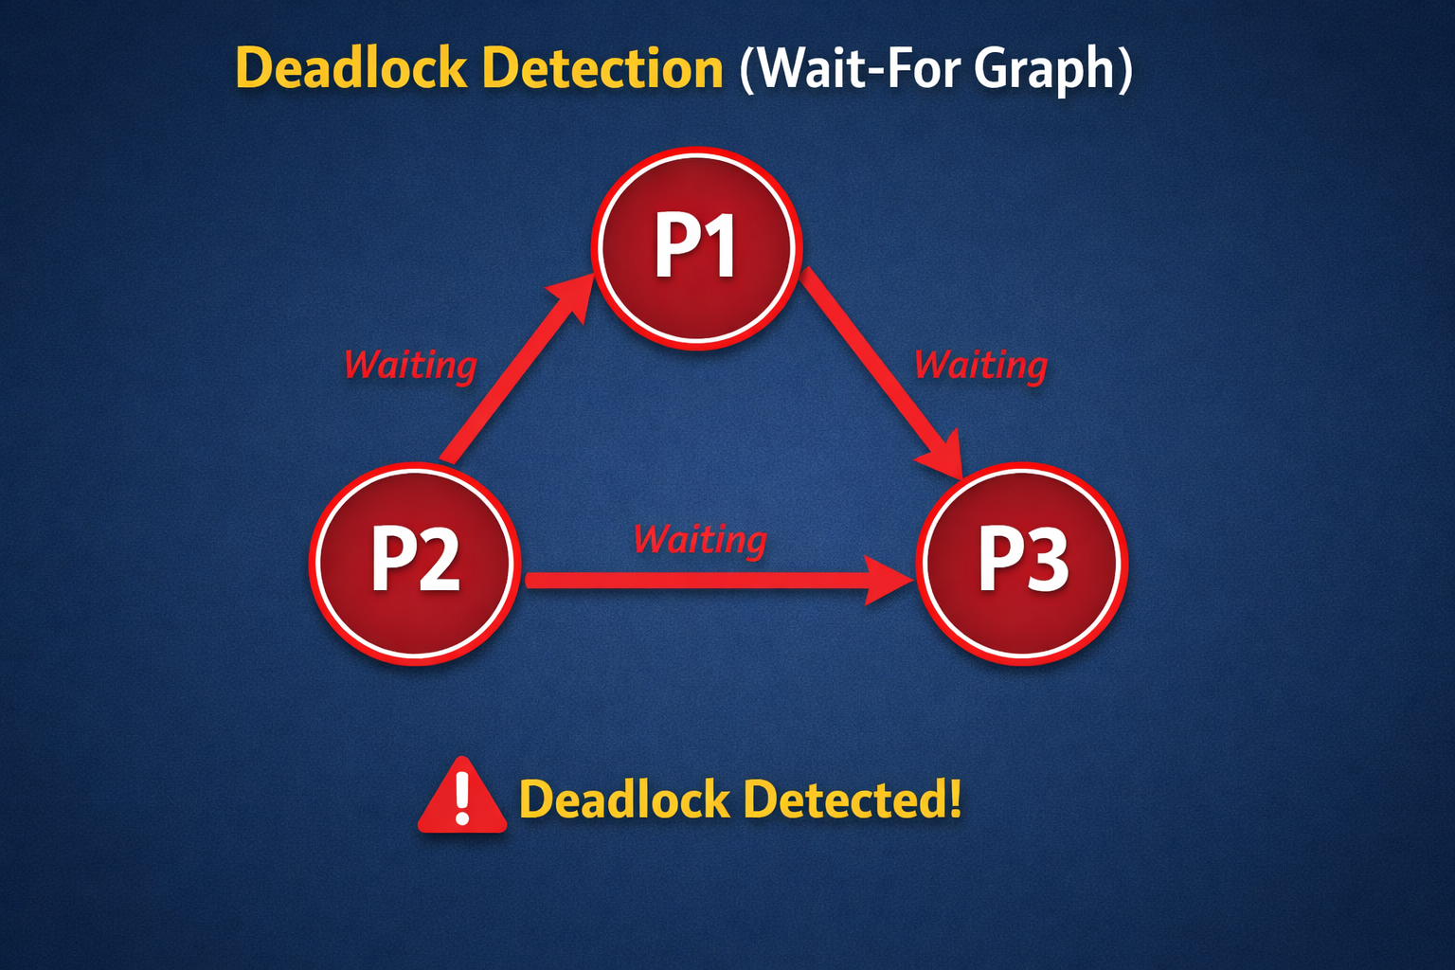
Deadlock Detection
In this method, processes are represented as nodes in a graph.
Edges represent dependencies between processes (who is waiting for whom).
If a process is waiting for another, an edge is drawn between them.
If the graph contains a cycle, it indicates a deadlock

Slide 9
Output & Features
Outputs:
Displays whether the system is in a safe or unsafe state.
Shows safe execution sequence if available.
Alerts when a deadlock is detected
Features:
Simulates multiple processes and resource types.
Performs real-time deadlock detection.
Suggests recovery actions (e.g., terminate process, release resource)Provides clear visualization of system state

Slide 10
Conclusion & Learning Outcomes
Deadlocks are critical problems that affect system performance and stability.
This simulator helps in understanding how deadlocks occur and how to prevent them.
It demonstrates practical implementation of resource allocation strategies.
Learning Outcomes:
Understanding of deadlock conditions and causes.
Knowledge of resource management techniques.
Practical implementation of Banker’s Algorithm.
Improved understanding of system reliability and efficiency

Slide 11

THANK YOU

